Slide 1
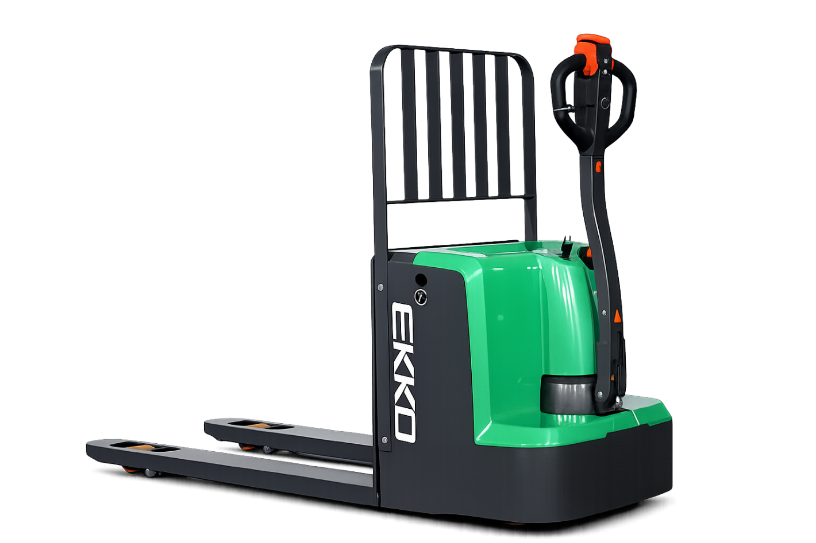

V25.01
EP18LI/EP20LI
ELECTRIC LONG-HANDLED
FORKLIFT TRUCK
PART MANUAL
202507

Slide 2
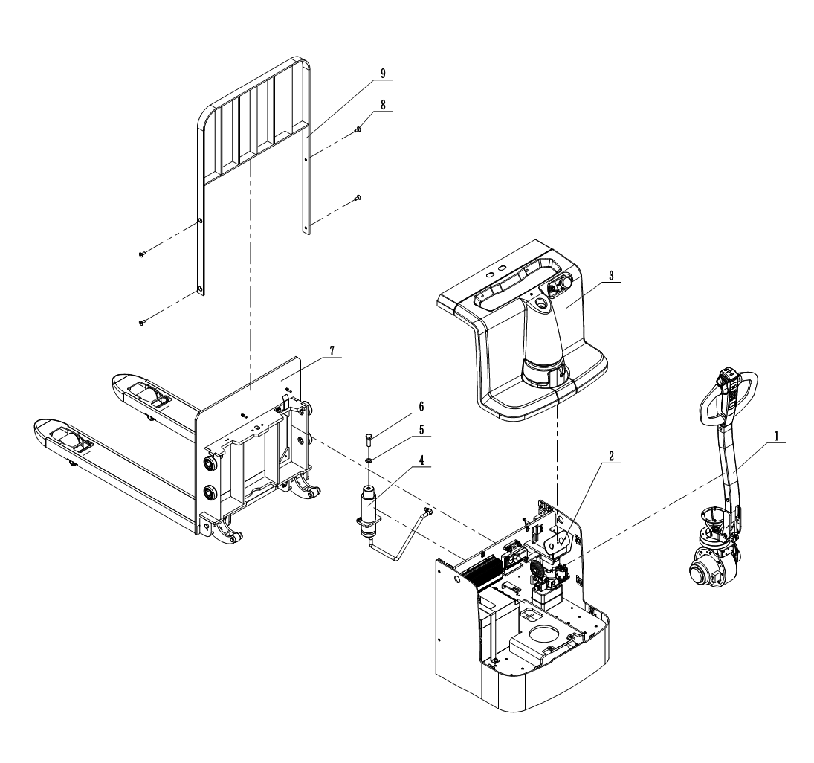
全电动搬运车 || ELECTRIC PALLET TRUCK
序号 Index | 代码 Part No. | 零件名称 | Part Name | 数量 Qty | 适用日期 Applied Date | 备注 Remark
1 | 20105110025 | 操作系统总成 | Operating System Assembly | 1
2 | 20105110027 | 车架组件 | Frame assembly | 1
3 | 20105110026 | 覆盖件总成 | Cover Assembly | 1
4 | 20105110028 | 油缸总成 | Oil cylinder assembly | 1
5 | 50101160010 | 六角头螺栓M16*50 | Hexagon bolt | 1
6 | 50501160001 | 圆形垫圈φ16 | Round washer | 1
7 | 20105110029 | 叉架组件 | Fork Bracket Assembly | 1
8 | 50203100009 | 内六角沉头螺钉M10*25 | Hexagon socket countersunk head screw | 4
9 | 20105060028 | 挡货架焊合 | Load Guard Welding Assembly | 1

Slide 3
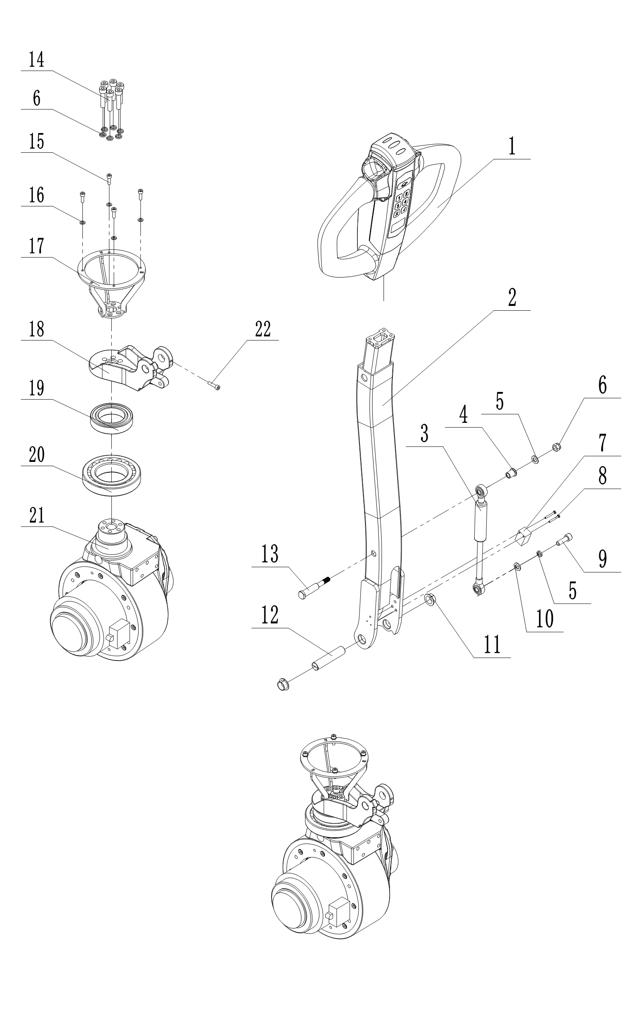
1. 操作系统总成 || Control System Assembly
序号 Index | 代码 Part No. | 零件名称 | Part Name | 数量 Qty | 适用日期 Applied Date | 备注 Remark
1 | 82601241011 | 操作手柄T410A-9C | Operating handle | 1
 | 82601240008 | 手柄总成T410A-9 | Handle Assembly | 1
2 | 75303010013 | 手柄杆焊合 | Handle bar assembly | 1
3 | 70912160004 | 气弹簧YQ16-70-245-700N | Gas spring | 1
4 | 70301050002 | 轴套 | Axle sleeve | 1
5 | 50511080001 | 弹性垫圈φ8 | Resilient washer | 8
6 | 50311080001 | 六角锁紧螺母M8 | Hex lock nut | 1
7 | 80119010009 | 接近开关AZ17M05PNK 10-30VDC | Approach switch | 1
8 | 50211030003 | 十字槽盘头螺钉M3×25 | Hexagon socket cap screw | 2
9 | 50201080010 | 内六角圆柱头螺钉M8×30 | Hexagon socket cap screw | 1
10 | 50501080001 | 圆形垫圈φ8 | Round washer | 7
11 | 72902160004 | 带肩复合衬套16*18*10/24 | Composite bush with shoulder | 2
12 | 70101160005 | 手柄销轴φ16*75 | Handle Pivot Pin | 1
13 | 70301050001 | 连接轴 | Connecting axle | 1
14 | 50201080007 | 内六角圆柱头螺钉M8×35 | Hexagon socket cap screw | 6
15 | 50201050023 | 内六角圆柱头螺钉M5×16 | Hexagon socket cap screw | 4
16 | 50501050001 | 圆形垫圈φ5 | Round washer | 4
17 | 77706050091 | 转向罩安装架 | Steering Cover Mounting Bracket | 1
18 | 77706050092 | 关节座 | Joint Hub | 1
19 | 50801500006 | 深沟球轴承6010-2RS | Deep groove ball bearing | 1
20 | 50802600002 | 圆锥滚子轴承30212 | Tapered roller bearing | 1
21 | 83101243007 | 驱动总成 | Drive Assembly | 1
22 | 50201050011 | 内六角圆柱头螺钉M5×20 | Hexagon socket cap screw | 1

Slide 4
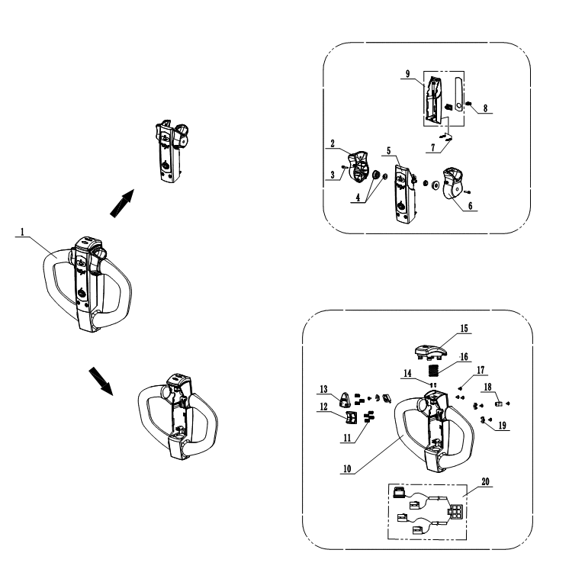
1.1 手柄总成 || Handle Assembly
序号 Index | 代码 Part No. | 零件名称 | Part Name | 数量 Qty | 适用日期 Applied Date | 备注 Remark
1 | 82601241011 | 操作手柄 | Operating handle | 1
2 | A7060355019 | 左加速器旋钮 | Left accelerator knob | 1
3 | A6162607017 | 平弹垫三合一螺栓 | Three-in-one flat spring washer bolt | 2
4 | A6162603016 | 轴内外套总成 | Inner/Outer Shaft Sleeve Assembly | 2
5 | A6163101032 | 加速器总成 | Accelerator assembly | 1
6 | A7060621066 | 右加速器旋钮 | Right accelerator knob | 1
7 | A6165102011 | 8.8级六角螺栓 | Grade 8.8 Hex Bolt | 2
8 | A7010110012 | 磁铁钥匙总成 | Magnetic key assembly | 1
9 | A6165109071 | 下盖面膜组件 | Lower cover facial mask assembly | 1
10 | A7060901031 | 大手柄上盖 | Large handle upper cover | 1
11 | A5020120011 | 压簧 | Pressure spring | 7
12 | A7010110013 | 升降按钮 | Lifting and lowering button | 1
13 | A6019001060 | 喇叭按钮 | Horn button | 1
14 | A7900301029 | 自攻螺丝 | Self-tapping screw | 2
15 | A8090124012 | 肚皮开关 | Emergency reverse button | 1
16 | A7310207916 | 压簧 | Pressure spring | 1
17 | A6117101611 | 自攻螺丝 | Self-tapping screw | 7
18 | A6163601011 | 尼龙线夹 | Nylon wire clamp | 3
19 | A5050103011 | 微动开关定位片 | Microswitch positioning plate | 3
20 | A5010112024 | 微动开关总成 | Microswitch assembly | 1

Slide 5
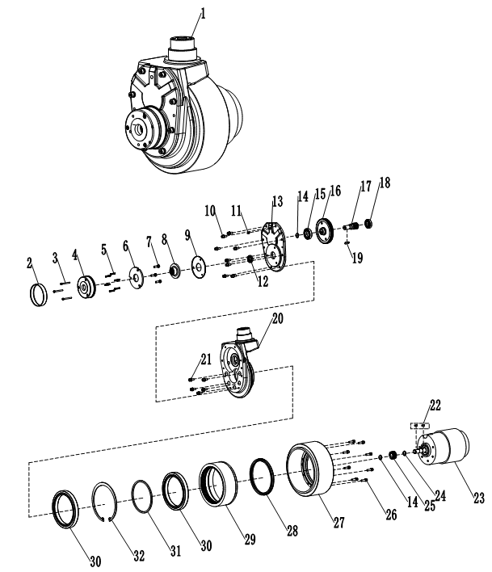
1.2 驱动轮总成 || Drive Wheel Assembly
序号 Index | 代码 Part No. | 零件名称 | Part Name | 数量 Qty | 适用日期 Applied Date | 备注 Remark
1 | 83101243007 | 驱动总成 | Drive Assembly | 1
2 | A7060355015 | 防尘皮圈 | Dust ring | 1
3 | A6162607013 | 内六角圆柱头螺钉 | Hexagon socket cap screw | 3
4 | A6162603011 | 制动器定子 | Brake stator | 1
5 | A6163101029 | 弹簧 | Spring | 6
6 | A7060621063 | 衔铁 | Link iron plate | 1
7 | A6165102008 | 六角头螺栓 | Hexagon bolt | 3
8 | A7010110008 | 摩擦盘 | Friction disk | 1
9 | A6165109068 | 摩擦板 | Friction plate | 1
10 | A7060901028 | 内六角圆柱头螺钉 | Hexagon socket cap screw | 8
11 | A5020120009 | 黄油嘴 | M8 Grease fitting | 1
12 | A7010110093 | 骨架油封 | Metal frame oil seal | 1
13 | A6019001052 | 齿轮箱后盖 | Gearbox rear cover | 1
14 | A7900301027 | 轴用弹性挡圈 | Shaft retaining ring | 2
15 | A8090124010 | 深沟球轴承 | Deep groove ball bearing | 1
16 | A7310207913 | 一级从动齿轮 | Driven gear | 1

Slide 6
1.2 驱动轮总成 || Drive Wheel Assembly
序号 Index | 代码 Part No. | 零件名称 | Part Name | 数量 Qty | 适用日期 Applied Date | 备注 Remark
17 | A6117101608 | 二级主动齿轮轴 | Driving gear | 1
18 | A6163601008 | 深沟球轴承 | Deep groove ball bearing | 1
19 | A5050103002 | 平键 | Flat key | 1
20 | A5010112020 | 驱动齿轮箱 | Drive gearbox | 1
21 | A8090125116 | 内六角圆柱头螺钉 | Hexagon socket cap screw | 5
22 | A8090125152 | 平键 | Flat key | 2
23 | A8090125117 | 电机总成0.75KW | Motor assembly | 1
24 | A2010506005 | 轴用弹性挡圈 | Shaft retaining ring | 1
25 | A7060810005 | 一级主动齿轮 | Driving gear | 1
26 | A7150101005 | 内六角圆柱头螺钉 | Hexagon socket cap screw | 8
27 | 71501111001 | 轮圈 | Wheel rim | 1
28 | A8260148006 | 骨架油封 | Metal frame oil seal | 1
29 | A8260148079 | 大齿圈 | Big gear ring | 1
30 | A8260148082 | 深沟球轴承 | Deep groove ball bearing | 2
31 | A8260148080 | 塑料垫圈 | Plastic washer | 1
32 | A8260148081 | 孔用弹性挡圈 | Hole-use resilient washer | 1

Slide 7
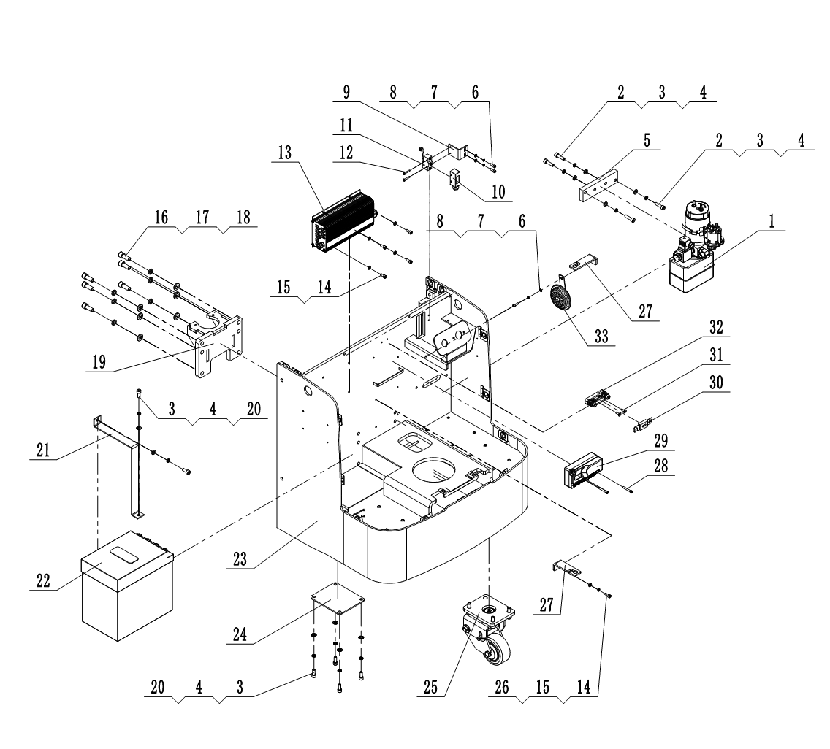
2. 车架系统 || Truck Body Frame
序号 Index | 代码 Part No. | 零件名称 | Part Name | 数量 Qty | 适用日期 Applied Date | 备注 Remark
1 | 61601243005 | 动力单元总成 | Power Unit Assembly | 1
2 | 50201080010 | 内六角圆柱头螺钉M8×30 | Hexagon socket cap screw | 4
3 | 50511080001 | 弹性垫圈φ8 | Resilient washer | 14
4 | 50501080001 | 圆形垫圈φ8 | Round washer | 14
5 | 77705050073 | 泵站安装板 | Pump Station Mounting Plate | 1
6 | 50201060005 | 内六角圆柱头螺钉M6*16 | Hexagon socket cap screw | 3
7 | 50511060001 | 弹性垫圈φ6 | Resilient washer | 3
8 | 50501060001 | 圆形垫圈φ6 | Round washer | 3
9 | 77705050074 | 限位开关安装板 | Limit switch mounting plate | 1
10 | 85100000001 | 微动开关防护罩 | Micro switch protective cover | 1
11 | 80101010018 | LXW5-11G1微动开关 | Micro switch | 1
12 | 50211040007 | 十字槽盘头螺钉M4×25 | Hexagon socket cap screw | 2
13 | 80912241043 | 充电器GBCH24V30A-B | Charger | 1 |  | Spring cord with US standard
14 | 50201060005 | 内六角圆柱头螺钉M6×16 | Hexagon socket cap screw | 4
15 | 50501060001 | 圆形垫圈φ6 | Round washer | 4
16 | 50201120002 | 内六角圆柱头螺钉M12×30 | Hexagon socket cap screw | 6

Slide 8
2. 车架系统 || Truck Body Frame
序号 Index | 代码 Part No. | 零件名称 | Part Name | 数量 Qty | 适用日期 Applied Date | 备注 Remark
17 | 50511120001 | 弹性垫圈φ12 | Resilient washer | 6
18 | 50501120001 | 圆形垫圈φ12 | Round washer | 6
19 | 20105060027 | 油缸安装座焊合 | Hydraulic cylinder mounting bracket weldment | 1
20 | 50201080003 | 内六角圆柱头螺钉M8×20 | Hexagon socket cap screw | 10
21 | 77705050076 | 电瓶抱箍 | Battery clamp | 1
22 | 81103243010 | 锂电池24V60A | Lithium Battery | 1
23 | 20105060029 | 配电箱焊合件 | Welded Electrical Distribution Box Assembly | 1
24 | 77705050077 | 曲柄垫板 | Crank Shim Plate | 2
25 | 20106110027 | 转向轮总成 | Steering Wheel Assembly | 2
26 | 50501060001 | 圆形垫圈φ6 | Round washer | 1
27 | 77706050062 | 挂线板 | Cable Mounting Plate | 2
28 | 50201050012 | 内六角圆柱头螺钉M5×35 | Hexagon socket cap screw | 2
29 | 80601243003 | 控制器D4P | Controller | 1
30 | 81601010002 | 保险丝ANL-200A | Fuse wire | 1
31 | 50203050003 | 内六角沉头螺钉M5×16 | Hexagon socket countersunk head screw | 2
32 | 81603010001 | ANL-N保险丝座 | Fuse holder | 1
33 | 80325010001 | 喇叭XJF-65/24V | Horn | 1

Slide 9
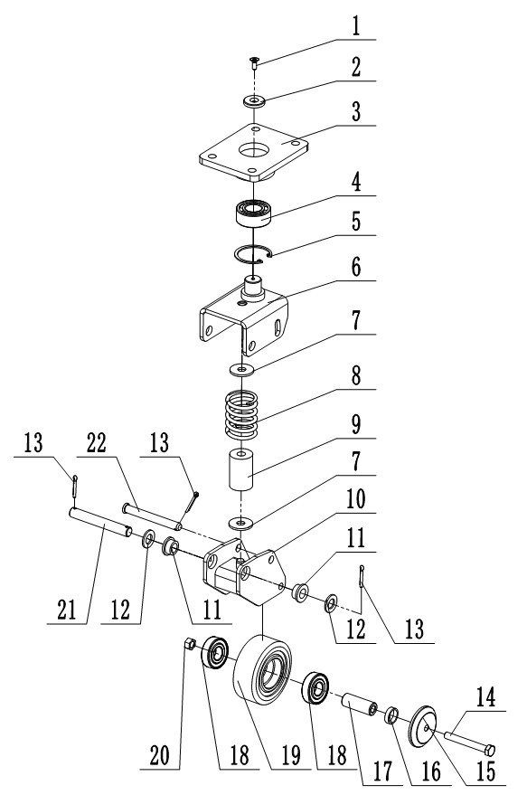
2.1 转向轮总成 || Steering Wheel Assembly
序号 Index | 代码 Part No. | 零件名称 | Part Name | 数量 Qty | 适用日期 Applied Date | 备注 Remark
1 | 50203060005 | 内六角沉头螺钉M6*16 | Hexagon socket countersunk head screw | 1
2 | 70608060002 | 转轴连接片6.5*32*5 | Pivot Link Plate | 1
3 | 77706050050 | 连接板焊合 | Welded Connection Plate Assembly | 1
4 | 50807250003 | 角接触球轴承S3205A-2RS | Angular Contact Ball Bearing | 1
5 | 50521522001 | 孔用弹性挡圈φ52 | Hole-use resilient washer | 1
6 | 77706050052 | 轮架焊合 | Wheel Bracket Welding Assembly | 1
7 | 70608120001 | 垫片12.5*36*3 | Washer | 2
8 | 70901050003 | 压缩弹簧φ5.8*48.6*60 | Compression spring | 1
9 | 73631110001 | 弹性体13*35*54 | Elastomer | 1
10 | 77706050051 | 旋转臂焊合 | Welded Rotating Arm Assembly | 1
11 | 70605150001 | 衬圈 | Bushing | 2
12 | 50501140001 | 圆形垫圈φ14 | Round washer | 2
13 | 50611040003 | 开口销φ4*24 | Split pin | 3
14 | 50101100020 | 六角头螺栓M10*80 | Hexagon bolt | 1
15 | 77706050053 | 防尘盖 | Dust Cover | 2
16 | 70608200004 | 垫圈20.5*25*6.5 | washer | 2
17 | 70605100003 | 轴套φ10*φ20*53 | Axle sleeve | 1
18 | 50801200002 | 深沟球轴承6204-2RS | Deep groove ball bearing | 2
19 | 71501110011 | 直轮φ100*40 | Load wheel | 1
20 | 50311100001 | 锁紧螺母M10 | Lock nut | 1
21 | 70101150003 | 销轴φ15*108 | Pivot Pin | 1
22 | 70101120005 | 销轴12*103 | Pivot Pin | 1

Slide 10
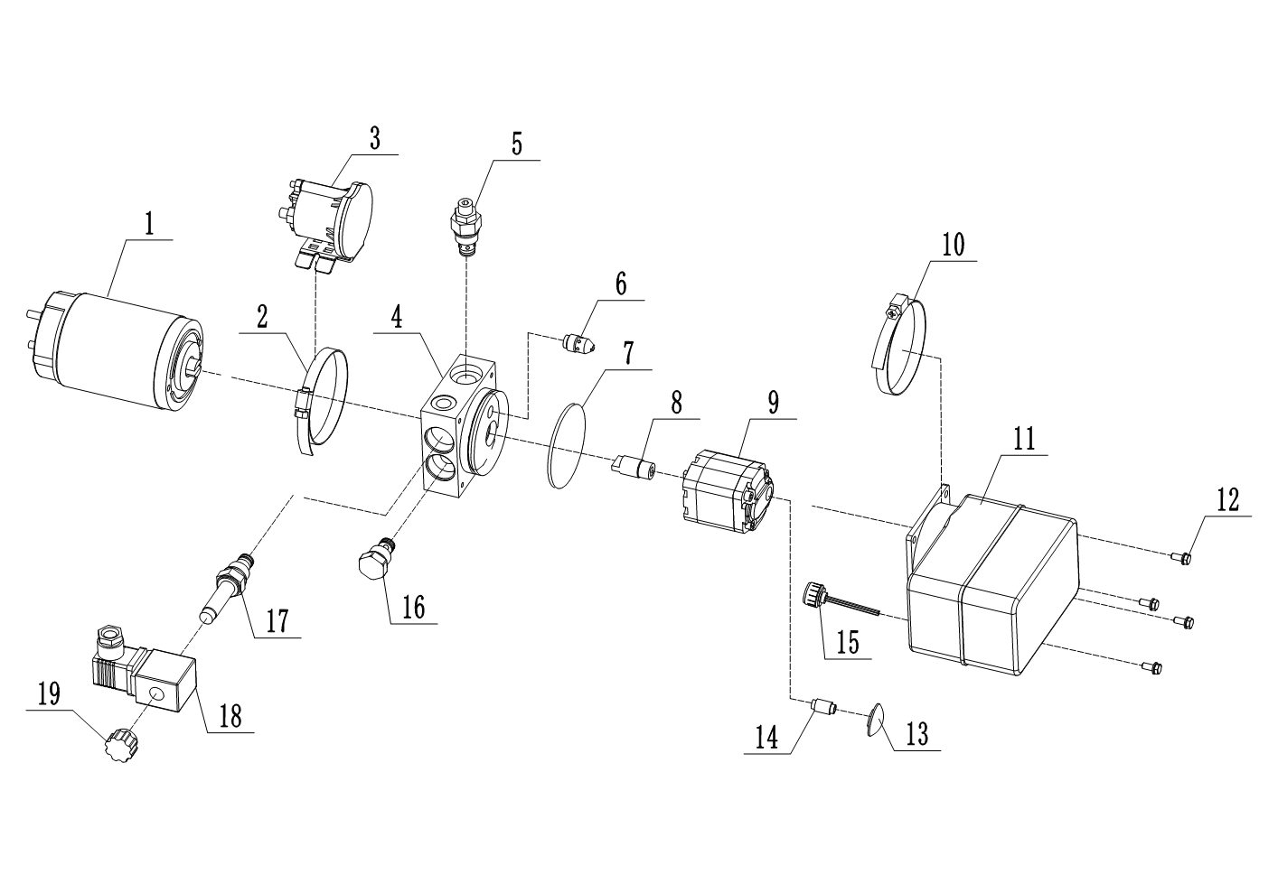
2.2 动力单元总成 || Power Unit Assembly
序号 Index | 代码 Part No. | 零件名称 | Part Name | 数量 Qty | 适用日期 Applied Date | 备注 Remark
1 | A5021102116 | 直流电机QS-24V-800W-A | DC motor | 1
2 | A7060355023 | 抱箍Φ65-Φ89 | Fastening hoop | 1
3 | A6162607024 | 接触器 DC24V 150A | Contactor | 1
4 | A6162603022 | 阀块 DLK31-303 | Valve block | 1
5 | A6163101037 | 直动式溢流阀YF08-00 | Direct-acting relief valve | 1
6 | A7060621071 | 压力补偿节流阀BLF06-G1/4-4L | Pressure-compensated flow control valve | 1
7 | A6165102016 | O型圈67-2.65 | O-ring | 1
8 | A7010110020 | 联轴器 | Coupling | 1
9 | A6165109075 | 齿轮泵CBU-F110 0.65cc/r右旋 | Gear pump | 1
10 | A7060901035 | 抱箍Φ105-Φ127 | Fastening hoop | 1
11 | A5020120015 | 油箱 73口径 1L | Oil box | 1
12 | A7010110021 | 六角头螺栓M5x16 | Hexagon bolt | 4
13 | A6019001064 | 滤网 43 | Filter mesh | 1
14 | A7900301034 | 吸油管 G1/4-G3/8-40 | Oil suction pipe | 1
15 | A8090124015 | 油箱盖 | Tank cap | 1
16 | A7310207919 | 单向阀钢球型 DF08-01 | Check Valve | 1
17 | A6117101615 | 常闭电磁阀(二位二通） HSV2-08-2NCP | Normally Closed Solenoid Valve | 1
18 | A6163601016 | 电磁阀线圈 DC 24V三插 | Solenoid Valve Coil | 1
19 | A5050103015 | 塑料螺母M10*20 | Plastic Nut | 1

Slide 11
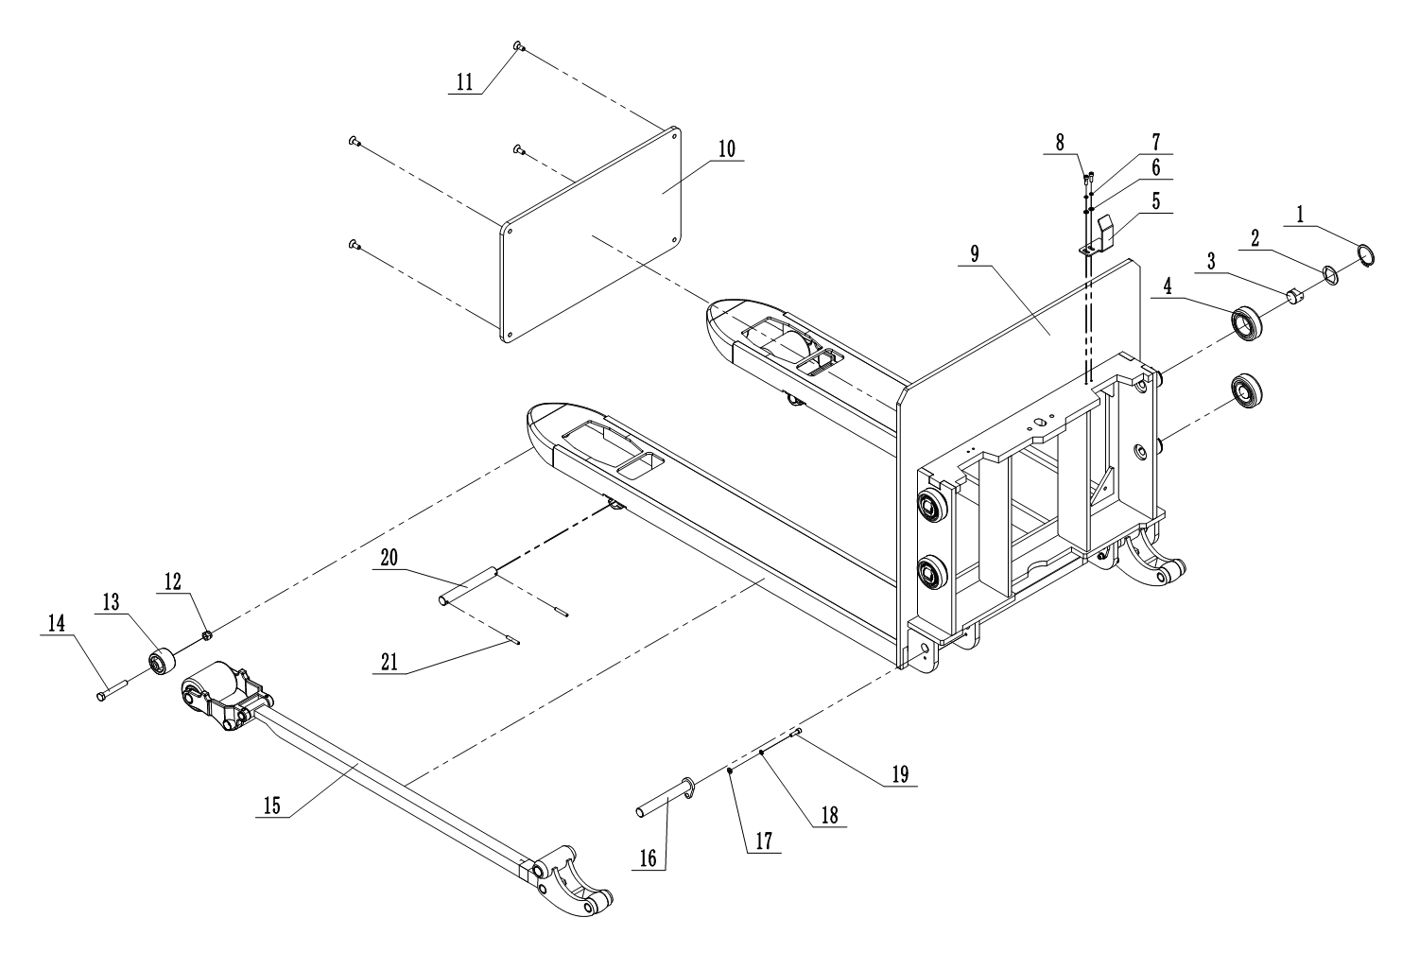
3. 叉架总成 || Fork Rack Assembly
序号 Index | 代码 Part No. | 零件名称 | Part Name | 数量 Qty | 适用日期 Applied Date | 备注 Remark
1 | 50521421001 | 轴用弹性挡圈φ42 | Shaft retaining ring | 4
2 | 79003010007 | 锁片 | Locking Tab | 4
3 | 71101010009 | 侧滚轮 | Side Roller | 4
4 | 71101010018 | 组合滚轮 | Combined Roller | 4
5 | 77705050078 | 起升限位板 | Lifting Limit Plate | 1
6 | 50501050001 | 圆形垫圈φ5 | Round washer | 2
7 | 50511050001 | 弹性垫圈φ5 | Resilient washer | 2
8 | 50201050003 | 内六角圆柱头螺钉M5*16 | Hexagon socket cap screw | 2
9 | 20105060030 | 叉架焊合 | Fork Bracket Welding Assembly | 1
10 | 77705050079 | 盖板 | Cover plate | 1
11 | 50203080006 | 内六角沉头螺钉M8*20 | Hexagon socket countersunk head screw | 4
12 | 50311100001 | 六角锁紧螺母M10 | Hex lock nut | 2
13 | 71503010001 | 进入滚子 | Entry roller | 2
14 | 50101100019 | 六角头螺栓M10*70 | Hexagon bolt | 2
15 | 75901110008 | 推杆组件 | Push Rod Assembly | 2
16 | 70101200037 | 销轴焊件φ20*146 | Pin shaft welded assembly | 2
17 | 50501060001 | 圆形垫圈φ6 | Round washer | 2
18 | 50511060001 | 弹性垫圈φ6 | Resilient washer | 2
19 | 50201060007 | 内六角圆柱头螺钉M6*20 | Hexagon socket cap screw | 2
20 | 70101200009 | 力臂销φ20*152 | Lever pin | 2
21 | 50601050006 | 弹性圆柱销φ5*35 | Spring pin | 4

Slide 12
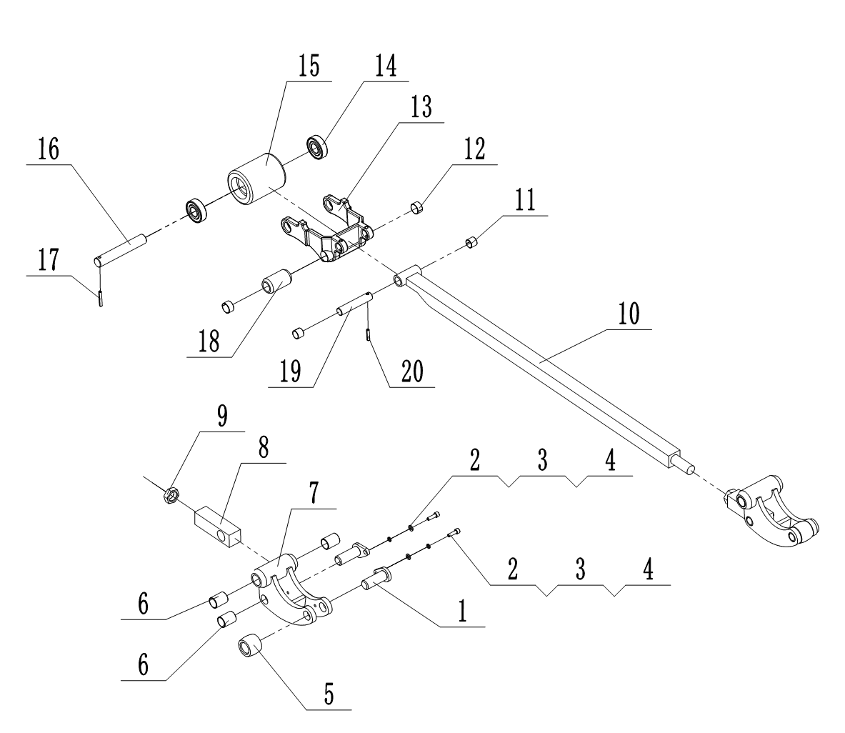
3.1 推杆总成 || Pushing Rod Assembly
序号 Index | 代码 Part No. | 零件名称 | Part Name | 数量 Qty | 适用日期 Applied Date | 备注 Remark
1 | 70101200038 | 销轴焊件 | Pin shaft welded assembly | 2
2 | 50201060007 | 内六角圆柱头螺钉M6×20 | Hexagon socket cap screw | 2
3 | 50511060001 | 弹性垫圈φ6 | Resilient washer | 2
4 | 50501060001 | 圆形垫圈φ6 | Round washer | 2
5 | 71101010012 | 滚轮φ23*30 | Roller | 2
6 | 72901200004 | 复合衬套φ23*φ20*30 | Composite bush | 3
7 | 77705050058 | 曲柄 | Crank | 1
8 | 75901210003 | 螺纹叉 | Threaded Fork | 1
9 | 50362200001 | 薄螺母M20*1.5 | Thin Nut | 1
10 | 75901010010 | 连杆焊件 | Welded | 1
11 | 72901160001 | 复合衬套φ18*φ16*15 | Composite bush | 2
12 | 72901200005 | 复合衬套φ23*φ20*15 | Composite bush | 2
13 | 75103010001 | 力臂架 | Force Arm Bracket | 1
14 | 50801200002 | 深沟球轴承6204-2RS | Deep groove ball bearing | 2
15 | 71501110003 | 直轮φ74*93 | Load wheel | 1
16 | 70101200039 | 轮轴φ20*122 | Wheel Axle | 1
17 | 50601050006 | 弹性圆柱销φ5*35 | Spring pin | 1
18 | 71503010003 | 退出滚子 | Exit Roller | 1
19 | 70101160006 | 推杆轴φ16*82 | Push Rod Shaft | 1
20 | 50601050003 | 弹性圆柱销φ5*26 | Spring pin | 1

Slide 13
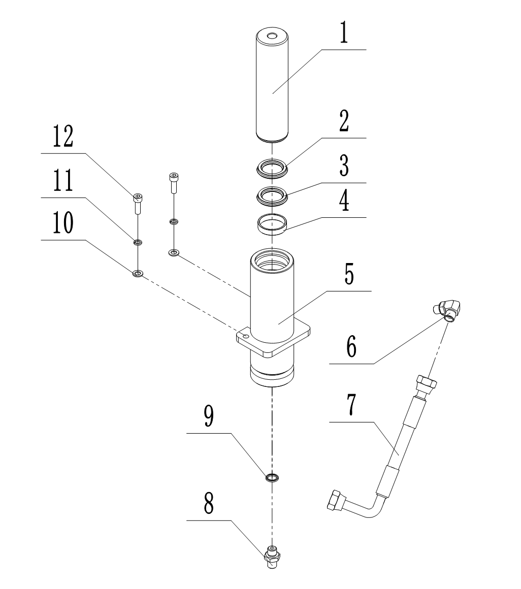
4. 油缸总成 || Oil Cylinder Assembly
序号 Index | 代码 Part No. | 零件名称 | Part Name | 数量 Qty | 适用日期 Applied Date | 备注 Remark
1 | A6162603021 | 活塞杆 | Piston rod | 1
2 | 61171210010 | 防尘圈φ50*φ58*5/6.5 | Dust proof ring | 1
3 | 61171110010 | 密封圈 φ50*φ60*6 | Seal ring | 1
4 | A6163101036 | 轴用耐磨环 | Shaft Wear Ring | 1
5 | A7060621070 | 缸筒焊件 | Cylinder Barrel Weldment | 1
6 | 60602010002 | 直角接头 | Right-angle joint | 1
7 | A6165102015 | 油管 | Oil pipe | 1
8 | 60601010023 | 油管接头 | Oil pipe joint | 1
9 | 60622140001 | 组合密封垫φ14 | Composite Seal Gasket | 1
10 | 50511080001 | 圆形垫圈φ8 | Round washer | 2
11 | 50511080001 | 弹性垫圈φ8 | Resilient washer | 2
12 | 50201080004 | 内六角圆柱头螺钉M8*25 | Hexagon socket cap screw | 2

Slide 14
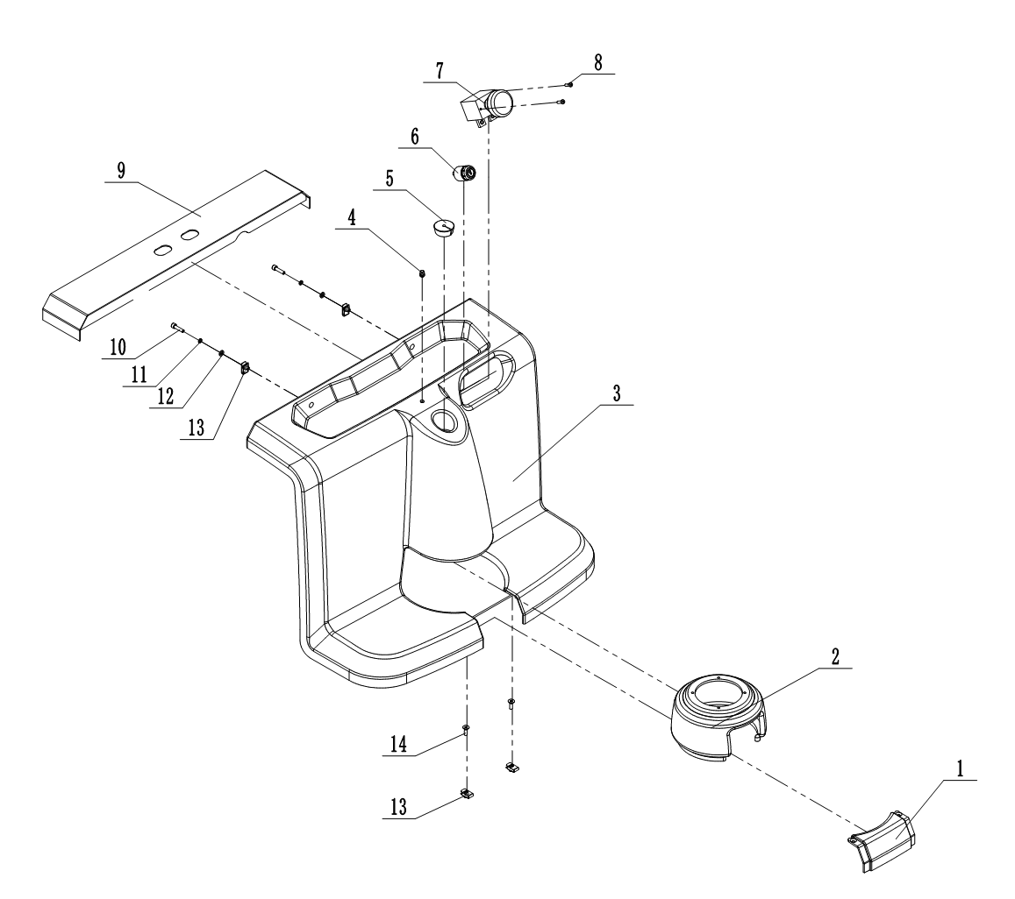
5. 覆盖件及其他 || Cover Assembly
序号 Index | 代码 Part No. | 零件名称 | Part Name | 数量 Qty | 适用日期 Applied Date | 备注 Remark
1 | 73506010003 | 面罩封板 | Mask Cover Plate | 1
2 | 73506010002 | 手柄罩 | Handle Cover | 1
3 | 73506010001 | 配电箱面罩 | Distribution Box Cover | 1
4 | 79003010010 | 金属灯座φ8 | Metal lamp holder | 1
5 | 73631070001 | 橡胶线塞 | Rubber cable grommet | 1
6 | 80109010001 | 钥匙开关JK530AMP | Key switch | 1
7 | 80107010002 | 急停开关ED250A | Emergency stop switch | 1
8 | 50211050001 | 十字槽盘头螺钉M5*16 | Hexagon socket cap screw | 2
9 | 77705050075 | 上盖焊合 | Welded top cover assembly | 1
10 | 50201060009 | 内六角圆柱头螺钉M6*25 | Hexagon socket cap screw | 2
11 | 50511060001 | 弹性垫圈φ6 | Resilient washer | 2
12 | 50501060001 | 圆形垫圈φ6 | Round washer | 2
13 | 70325060001 | 弹簧卡扣螺母M6 | Spring Clip Nut | 4
14 | 50203060007 | 内六角沉头螺钉M6*20 | Hexagon socket countersunk head screw | 2

Slide 15
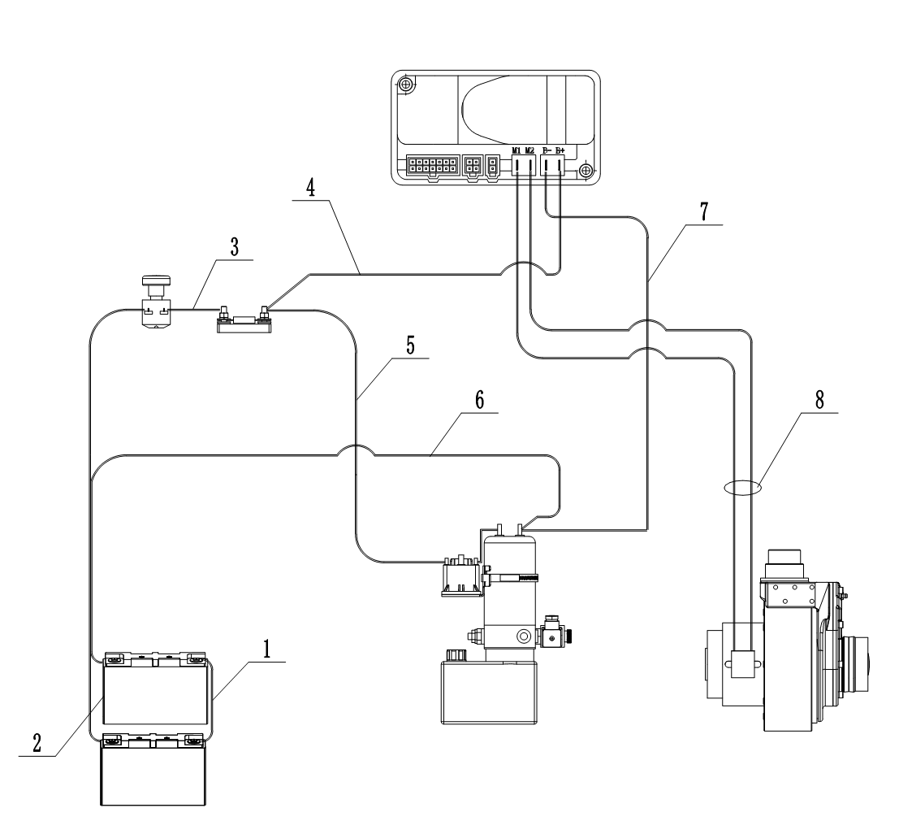
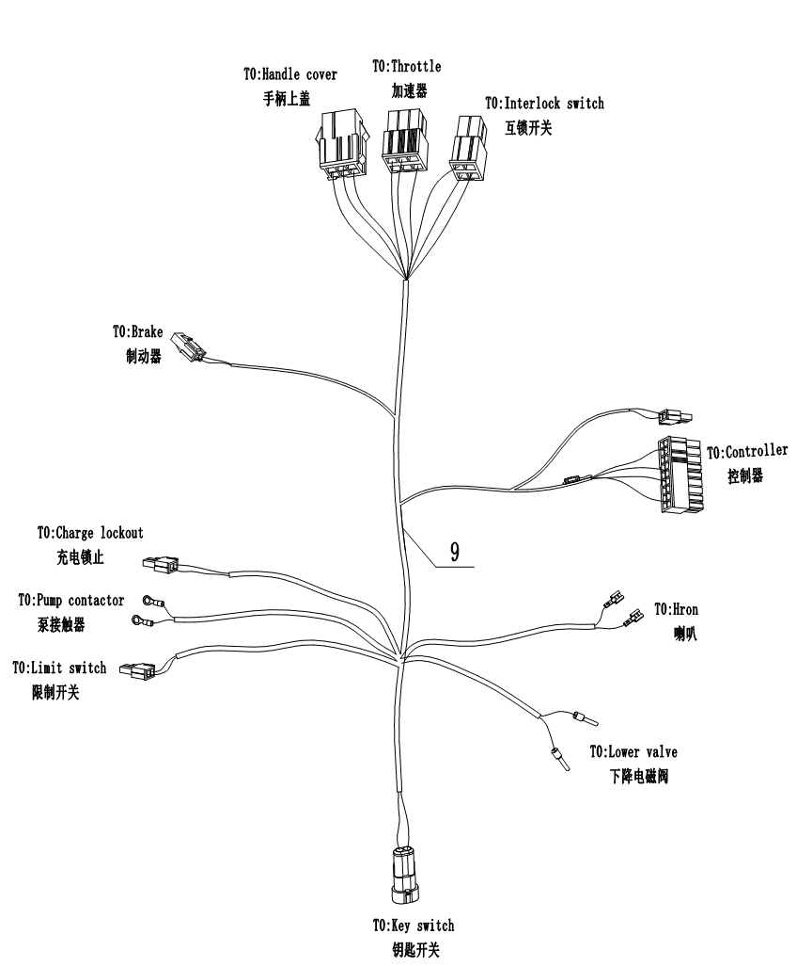
5. 动力线部装图 || Power Line Assembly Drawing
序号 Index | 代码 Part No. | 零件名称 | Part Name | 数量 Qty | 适用日期 Applied Date | 备注 Remark
1 | 83711050046 | 电池连接电缆线 | Battery connection cable | 1
2 | 83711050047 | 电池正极--急停电缆线 | Battery positive to emergency stop cable | 1
3 | 83711050048 | 急停--保险电缆线 | Emergency stop to fuse cable | 1
4 | 83711050049 | 控制器正极电缆线 | Controller positive cable | 1
5 | 83711050050 | 泵电机正极电缆线 | Pump motor positive cable | 1
6 | 83711050051 | 泵电机负极电缆线 | Pump motor negative cable | 1
7 | 83711050052 | 控制器负极电缆线 | Controller negative cable | 1
8 | 83711050053 | 电机线材组件 | Motor wiring harness assembly | 1
9 | 83701050030 | 控制线束 | Control wiring harness | 1

Slide 16
4. 易损件清单 || Wear-and-Tear Parts List
序号 Index | 代码 Part No. | 零件名称 | Part Name | 数量 Qty | 图片/位置 | 备注 Remark
1 | 80325010001 | 喇叭XJF-65/24V | Horn | 1 | 2/33
2 | 80119010009 | 接近开关 AZ17M05PNK 10-30VDC | Approach switch | 1 | 1/7
3 | 71501110011 | 直轮φ100*40 | Load wheel | 2 | 2.1/19
4 | 80101010018 | 微动开关LXW5-11G1 | Micro switch | 1 | 2/11
6 | 81601010002 | 保险丝200A | Fuse wire | 1 | 2/30
7 | 71501110003 | 直轮φ74*93 | Load wheel | 2 | 3.1/15
8 | 50801200002 | 深沟球轴承 6204-2RS | Deep groove ball bearing | 2 | 3.1/14
9 | 71101010012 | 滚轮φ23*30 | Roller | 2 | 3.1/5
10 | 50807250003 | 角接触球轴承S3205A-2RS | Double-Row Angular Contact Ball Bearing | 1 | 2.1/4
11 | 50802600002 | 圆锥滚子轴承 30212 | Tapered roller bearing | 1 | 1/20
12 | 50801500006 | 深沟球轴承 6010-2RS | Deep groove ball bearing | 1 | 1/19
13 | 70912160004 | 气弹簧YQ16-70-245/700N | Gas spring | 1 | 1/3
14 | 61171210010 | 防尘圈φ50*φ58*5/6.5 | Dust proof ring | 1 | 4/2
15 | 61171110010 | 密封圈φ50*φ60*6 | Seal ring | 1 | 4/3
序号 Index | 代码 Part No. | 零件名称 | Part Name | 数量 Qty | 图片/位置 | 备注 Remark

